Slide 1

College Recruiting
Amelia Island Soccer

Slide 2
Agenda
Getting Started
Atmosphere
Academics/Scholarships
Communication
Additional Resources

Slide 3
Getting Started
Atmosphere
Academics/Scholarships
Communication
Additional Resources
Getting Started

Slide 4
Suggested Timelines
Timelines below can vary by school and male/female athletes*
Freshman-Soph Year
Athletes write to a large number of schools to state your interest
Visit campuses
Soph-Junior Year
Determine your realistic level of
play
Narrow your school list down to
those that have the right fit (~15)
Club coach can help to be liaison if college coaches show interest
Discuss with parents the financial aspects
Junior-Senior Year
Majority of players make
commitments
List of schools should be narrowed
to 3-5
If you are not getting communication from coaches, shift focus elsewhere

Slide 5
Umbrella Organizations
NCAA Division I/II
Other
NAIA or NJCAA
NCAA Division III

Slide 6
Umbrella Organizations
• Eligibility Center is the organization within the NCAA that determines the
academic eligibility and amateur status for all NCAA DI and DII athletes
• You need to register and be cleared by the NCAA if you want to play NCAA
college sports and receive a scholarship at the DI or DII level
• Cost for registration is $90 for US citizens
• Create an account and make payment
• High School submits official transcripts
• SAT or ACT testing center sends official test results
• Answer amateur status questionnaire
• Once everything above is completed, NCAA will not review your information
unless it has been requested by an NCAA University
• If you have registered with the NCAA and have not had your eligibility status
completed, chances are it has not been requested by a coach
• Over 60% of athletes who are registered with the NCAA are never recruited by a
college coach

Slide 7
Coaches Communication
Division I & II
Freshman & Sophomore Year
• Prospect can send unlimited emails, texts, and make phone calls
• Prospect can receive camp or clinic invitations
After 1 Sept of Junior Year
• Coaches can get involved with a recruit’s unofficial visit
• Recruits can start taking official visits
• Recruits & college coaches can have recruiting conversations during camps
• Coaches can make phone calls and send direct emails
Division III
Contact prospects at any time during high school

Slide 8
Getting Started
Atmosphere
Academics/Scholarships
Communication
Additional Resources
Atmosphere

Slide 9
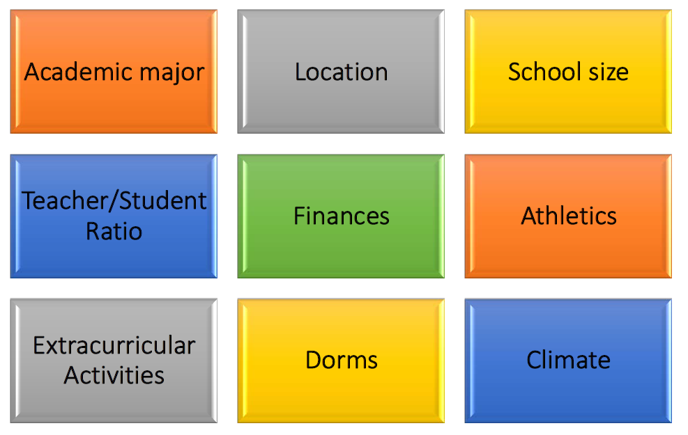
What to Consider

Slide 10
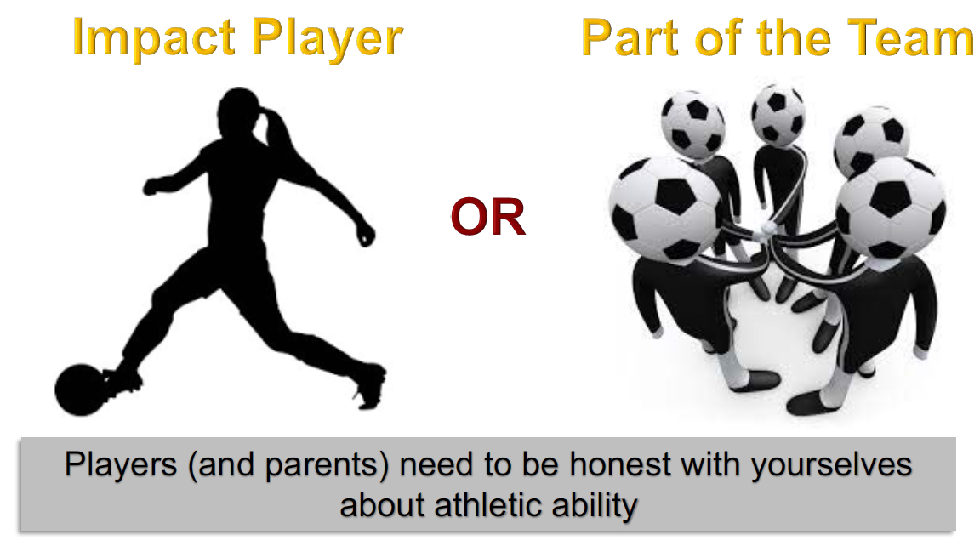
Where Do You Fit

Slide 11
Division I Statistics
Girls Statistics
• 9.7% of U.S. high school players end up playing collegiately
• 2.3% end up playing Division I
• 3% of college recruits are international players
Boys Statistics
• 7.9% of U.S. high school players end up playing collegiately
• 1.1% end up playing Division I
• 21.3% of college recruits are international players
*Based on a 2017 study done by NCSA (ncsasports.org). Trend towards international recruits is growing.

Slide 12
Do Your Research
Make a list of potential schools
Research these schools
• Campus visits
• Online Resources
Spend some time researching how to write a good letter to coaches

Slide 13
Getting Started
Atmosphere
Academics/Scholarships
Communication
Additional Resources
Academics & Scholarships

Slide 14
Academics
• Academics need to be the FIRST priority
• Freshman-Senior years focus on good grades and good SAT/ACT scores
• Coaches are looking for recruits who can balance school and sports
• Make certain to research schools with your major
• Recommend taking the PSAT in your freshman or sophomore year.
• Take the SAT and/or ACT no later than the end of your junior year – these are important to help predict your opportunity for merit based scholarships
• Everyone should complete a FAFSA application. Don’t assume you don’t qualify!
• Complete Oct of your senior year, using prior year tax information.

Slide 15
Scholarships
• Division I/II schools offer a variety of athletic scholarships
- Fully funded athletic scholarship
- Partial athletic scholarship
- Combined athletic and academic
- Academic
• Division III does not offer athletic scholarships
• Division I fully funded schools have ~9.9 scholarships for men and ~14 for
women (average rosters include 28-29 players)
• Division II fully funded schools have 9 scholarships for men and 9.9 for
women
• NAIA schools can offer up to 12 fully funded athletic scholarships
• Junior Colleges can offer up to 18 fully funded athletic scholarships
• Not all schools are fully funded
• All Divisions offer Financial and Merit-based scholarships

Slide 16
Getting Started
Atmosphere
Academics/Scholarships
Communication
Additional Resources
Communications

Slide 17
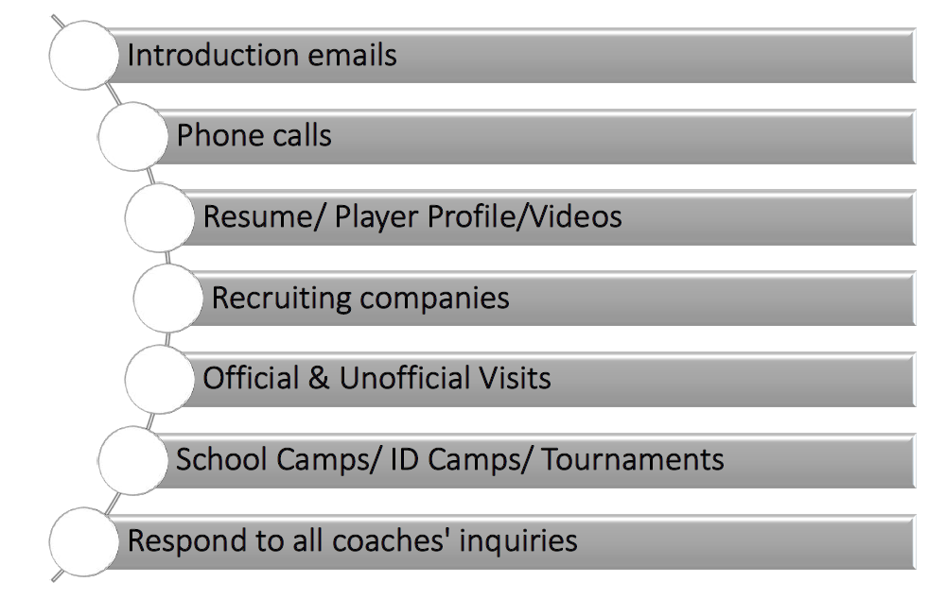
Contacting Schools

Slide 18
Athletes vs Parents
• Step aside parents – coaches want to hear from the athletes
• Coaches are more impressed when….
• Recruits speak more than the parents
• Recruits are the point person for email and phone communication
• Recruits are asking the questions versus parents

Slide 19
Where to Start
Don’t be overwhelmed! Here’s how to start:
• 2-3 weeks before every tournament, check online for the college coaches that are attending
• Send emails to several different coaches expressing interest and inviting them to see you play
  - Write to a variety of schools, not only the 1-2 you’ve heard of before
  - Cast a wide net: Writing 5 schools is better than nothing… but writing 15-20 is ideal
• Make sure you include:
  - Your schedule/ game times/ team name
  - Your jersey number and position
  - Your HS graduation year
  - Your club coaches contact info
• Follow up after your tournament to see if they had a chance to see you play, and express your
interest again
• Schools that are interested will contact you!
• Determine if you are potentially interested in that school, based on the other factors
  - If possibly interested, keep the communication going!
  - If not interested, thank them for their interest, but advise you aren’t overly interested.
• Start writing coaches in your sophomore year, but don’t be upset if you don’t get responses

Slide 20
Additional Resources
• NCAA Eligibility Center
https://web3.ncaa.org/ecwr3/
• NCAA Eligibility Center FAQ
https://ncaa.egain.cloud/kb/EligibilityHelp/home
• NCAA Eligibility Center Registration Checklist
http://fs.ncaa.org/Docs/eligibility_center/Student_Resources/Registration_Checklist.pdf
• NCAA Division I Eligibility Standards
http://www.ncaa.org/student-athletes/play-division-i-sports
• NCAA Division II Eligibility Standards
http://www.ncaa.org/student-athletes/play-division-ii-sports
• NCAA Recruiting Fact Sheet
http://www.ncaa.org/sites/default/files/Recruiting%20Fact%20Sheet%20WEB.pdf

